Slide 1


GIFT: Internationalization and Core GIFT Enhancements
April 9, 2021 - Technical status meeting
BAA W911NF-19-C-0043

Slide 2



AWS Maintenance
AWS / RDS Current State – Complete Audit of Existing Systems Complete
Group GIFT Instance Nuxeo VM Database
GIFT
Cloud
(Production)
GIFTCloudWindows
1000 GB
34.223.241.235
GIFTCloudNuxeo
1000 GB
giftclouddbpostgre
100 GB
Currently testing GIFT-CaSS Baseline
AWS
Cloud
Testing
GIFTSSIDevWindows
150 GB
52.43.174.125
GIFTSSIDevNuxeo
128 GB
Giftssidevrds
100 GB
Feasibility Study for Linux Version of GIFT Complete – Moving to Native Solution
Linux
GIFT-port
Testing
GIFTCoreLinux
128 GB
GIFTCoreLinuxRDS
100 GB
Notes:
All AWS machines are up and nominal for the core stakeholder group.
Some assistance to a new stakeholder this week – basically helping them setup a Nuxeo build that can be zipped up and deployed locally based off of a vanilla AWS Nuxeo instance deployment.
We’ll track progress here:
https://www.gifttutoring.org/projects/synapticsparks/wiki/Running_GIFT_on_Linux_Server
More work and news to follow!

Slide 3
AWS Maintenance
AWS / RDS Current State
GIFTCloudELGG
30 GB
GIFTPiwikBitnami
10 GB
GIFTCloudMonitoring
40 GB
Support
VMs
CaSSWindowsServer
128 GB
CaSSFedoraCore
32 GB
CaSSDebianCore
32 GB
Various Image Copies
Estimated Monthly Cost: Estimated at roughly $1,800
Notes:
Costs remain stable on a monthly basis at about $1.8K per month.

Slide 4
STEEL-R SUPPORT
Participating in the Weekly Huddle and (2) Integration Jams
  STEEL-R Huddle – Items of Interest
    Planning Near, Mid and Long term calendars at Ft. Hood WSTC – Scenarios with Ft. Hood Terrains – Significant activity to get involved with.
    Excited for Increment 2 – unknowns wrt the TIF --- waiting for them to get a scenario in place.
    Summer rotation at Ft Hood – VBS 3 scenarios on Ft Hood terrains. Ft Knox soldiers will be training at WSTC need to support with exercise designs – explore different ranges (Jeanine --- IRB requirements) Question: Is there a current timeline of this initiative?
    Movement on the TIF – potential to host everything local and distribute from central location.
    Building out a draft for the ITSEC paper – Ben: Who do you need support from?
  Other Items of Interest:
  Cease all Communications Over Non-Secure Networks – Ben, Any Updates?
  Discussion, How Does the Competency Tested Feedback into the Scenario Homework Assignment – Review Design Recommendations for ITS’s, Volume 8, Data Visualization Chapter 3 – THE GIFT OF SCRUTABLE LEARNER MODELS: WHY AND HOW
  SSI GIFTSym7 – GIFT, Competencies, VR and Biometrics Applied to Squad Training

Slide 5
TIMEd surveys
Our original idea was to add two columns to the SurveyPage database table. These two columns were TIMED and COMPLETIONTIME. TIMED was a boolean value to check if a survey page was timed or not (represented in the UI by a check box) and completiontime was an integer that held how much time a student had to complete a survey page, in seconds.
We successfully added these two columns by adding the two variables boolean isTimed and int completionTime to DbSurvey.java and its associated classes. This appeared to work, and the values for each column were saved and updated correctly. However, we did notice that when trying to take a survey, the page would hang while loading and never present the survey.

Slide 6
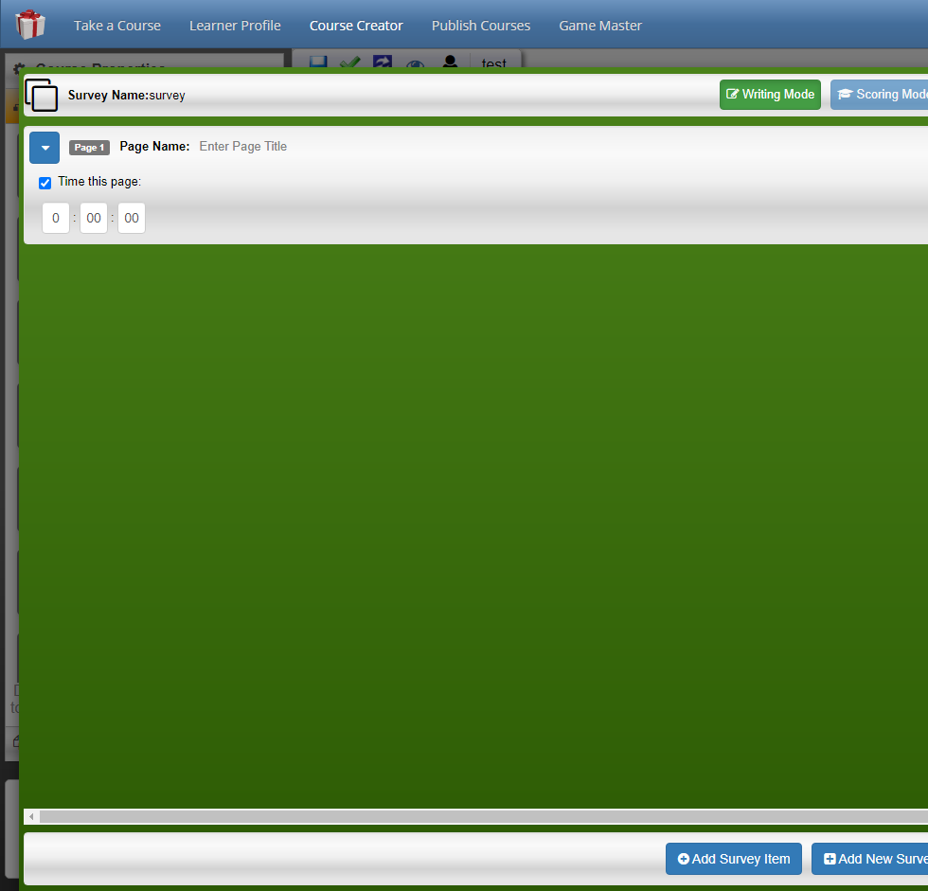
TIMED surveys (Contd.)
Our current path forward is to instead add our two properties isTimed and completionTime to SurveyProperties.java
Peer review revealed to us that adding more columns to the database would make the database unnecessarily more complex.
Current status and delivery discussion.

Slide 7
GIFTSym9 – Submission Schedule
Abstract Submission Deadline - 14 (24) March 2021
  SSI to submit abstract for Short Paper on Analyzing Team Competency Aggregations and Profiles in GIFT (AISs)
Acceptance Notification - 26 March 2021
Paper Submission Deadline - 06 May 2021
Presentation Submission Deadline – 21 May 2021
GIFTSym9 – 26-28 May 2021, Virtual*
Notes:
Work on the GIFTSym9 paper has now begun, started with the research and studies into current state of the industry on team competencies and constructing learner profiles in GIFT.
We’re kind of assuming the abstract and paper topic was acceptable? Any comments from the group?
As always we invite coauthors or anyone that would like to work with us for our usual style of GIFTSym presentation – part research, part development, and with a prototype of some new software and system configuration utilizing GIFT moving forward.

Slide 8
Other upcoming priorities
Proposal for Next Major Tasking Set Submitted
  Amazon Web Services for Core GIFT Team and Experiments
    Focus on using proven deployment instructions to assist community with hosting their own GIFT servers, rather than immediately and directly supporting by hosting ourselves
  Data Visualization and Team-Focused Instructor GUI Tool Extensions
  Wearable “IOT” Smart Sensors and Clothing
    Focus on team performance assessment that becomes possible through the “hive” sensor data. Possibly integrate with mobile technologies.
  Data Analytics and xAPI Interface Development
  STEEL-R / CaSS / KSA-Based Course Content Tagging, Assessments, and Recommendations
    Individual and Team Level Interfaces
  GIFT Core Architecture Research and Enhancements (Native Linux Ops) – Considered the current major focus
Notes:
Skim through this slide – basically let the team know that our priorities may or may not include the tasks on the slide based on discussions on efforts.
Major focus will be furthering GIFT running natively in Linux until otherwise noted.
As always, we defer to GIFT team leadership to direct the priority of efforts and/or adjust this work schedule as they see fit. Thank them for their input either now or offline later.

Slide 9
Overall Priorities
Current Tasking, In Order of Priority (Please Comment if Needed)
  Send Final Reports and Next Proposal to CO
  Vanderbilt Video Processor Task
  Deliver feasibility study for GIFT-to-Linux port, and VM-in-VM study (In progress on Wiki)
  Deliver Timed Survey build (different branch from 1+ years ago, ‘Alpha’ functionality as the auto timed-progression still had 1 critical bug. Will reanalyze with merged current GIFT trunk baseline)
  GIFTSym9 Paper Abstract Submission + Follow-On Tasks
  Perform AWS updates for RDS and Certs, Downtime Event
  Continue working highest-priority GIFT-CaSS tickets
  Support STEEL-R meetings and guide GIFT-CaSS I&T from requirements
  Deliver “Phase I” of GIFT-CaSS I&T
  Assist GIFT stakeholders deploy AWS GIFT instances
  Audit AWS Systems for potential stoppages and backup local copies
  Resolve final i18n GAT Language Pack challenges with DT, and assist with test plans and any other issues possible

Slide 10
Reference Slides

